Slide 1
AEP Profile toolkit
Configuration guide — Adobe Auth & Profile Viewer
Secrets stay in .env (never commit). Node.js + AEP sandbox required.

Slide 2
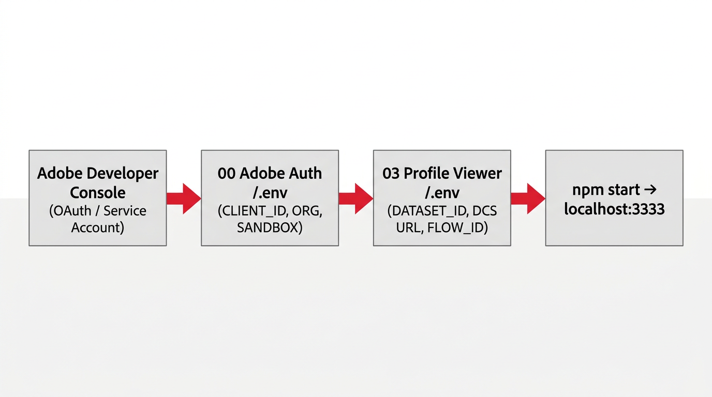
Configuration flow overview

Slide 3
Prerequisites
Install Node.js (LTS)
Adobe Developer Console project (Service Account)
AEP sandbox access

Slide 4
00 Adobe Auth — .env
ADOBE_CLIENT_ID / SECRET — from Developer Console
ADOBE_IMS_HOST — NA or EU IMS host
ADOBE_SCOPES — must match integration
ADOBE_ORG_ID — org@AdobeOrg
ADOBE_SANDBOX_NAME — AEP sandbox
Verify: npm run test-auth
[Add screenshot] Developer Console credentials

Slide 5
03 Profile Viewer — .env
Copy .env.example → .env
AEP_QUERY_PROFILE_DATASET_ID — search / Query Service table
AEP_PROFILE_STREAMING_URL — DCS collection URL
AEP_PROFILE_FLOW_ID — dataflow ID
Optional: streaming API key, event URLs — see .env.example

Slide 6
Streaming: HTTP API source
Sources → HTTP API — create connection
Copy collection URL to AEP_PROFILE_STREAMING_URL
Dataflow → Profile dataset + Data Prep
Note flow ID for AEP_PROFILE_FLOW_ID
[Add screenshot] AEP Sources — HTTP API

Slide 7
Run Profile Viewer
cd "03 Profile Viewer" && npm start
http://localhost:3333 — lookup by email
/search.html — partial email search
Serve via Node — not file:// or Live Server
[Add screenshot] Local app in browser

Slide 8
Security & sharing
.env is gitignored
Map from Postman env if you use EMEA Demo
Key Vault option in 00 Adobe Auth README
Add PNGs per screenshots/WHICH-FILES.txt — npm run generate to refresh

